Slide 1
From Enumeration to Root: Exploiting EvilBox: One
This report presents a detailed security assessment of the EvilBox: One virtual machine from VulnHub, conducted in a controlled lab environment. The objective of this exercise was to simulate a real-world penetration testing scenario by identifying vulnerabilities, exploiting misconfigurations and ultimately gaining unauthorized access to the system.
The assessment follows a structured methodology, including reconnaissance, enumeration, exploitation and post-exploitation. Throughout the process, various tools and techniques were used to uncover weaknesses within the system and demonstrate how an attacker could leverage them to escalate privileges.
This project highlights the importance of proper system hardening, secure configurations and continuous security testing to mitigate potential threats in real-world environments.
Created by: ryan brian odhiambo

Slide 2
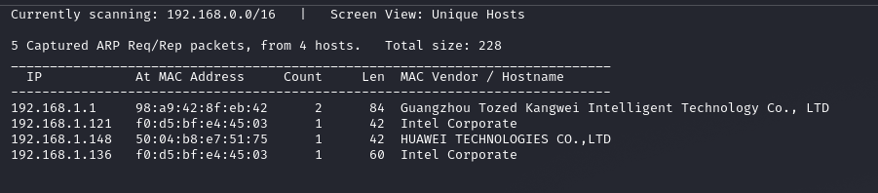
Host discovery
Running an ARP scan against the /16 subnet revealed only 4 active hosts, one of which is our target at 192.168.1.136.
Interestingly, two different IPs share the same Intel MAC address this is worth investigating further, as it could indicate network spoofing or a misconfigured multi-IP device.

Slide 3
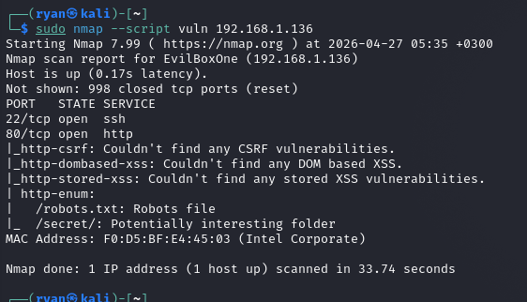
Vulnerability Scanning – Nmap Script Scan
After the ARP discovery scan identified the target at 192.168.1.136, we ran a vulnerability scan using Nmap's --script vuln option. The scan revealed only two open ports: SSH on port 22 and HTTP on port 80 – a very limited attack surface.

Slide 4
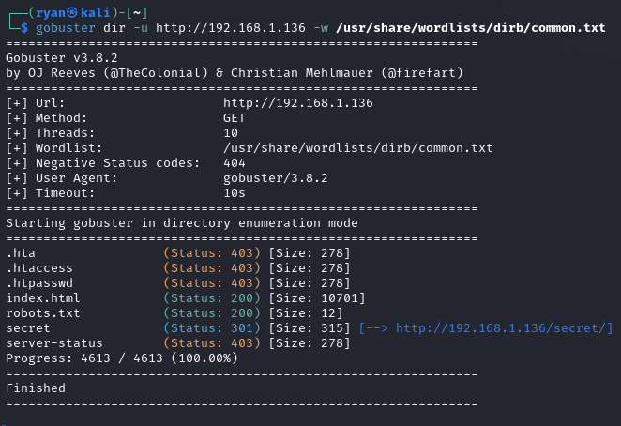
Directory enumeration using gobuster.
The scan successfully discovered a hidden directory (/secret/) and confirmed the presence of restricted sensitive files, indicating potential entry points for further enumeration and exploitation.

Slide 5
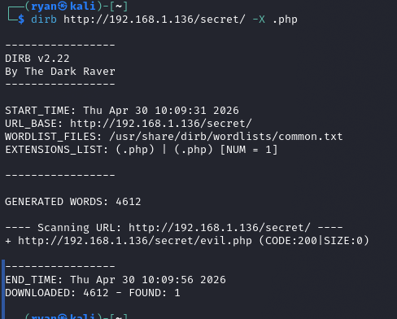
Directory enumeration using dirb.
While further enumerating web directories with DIRB, we discovered an unusual file: evil.php inside the /secret/ folder. The server returned a 200 OK status, but the response size was zero bytes—indicating the script executes silently. In real-world pentests, this is often a sign of a web shell or command execution backdoor.

Slide 6
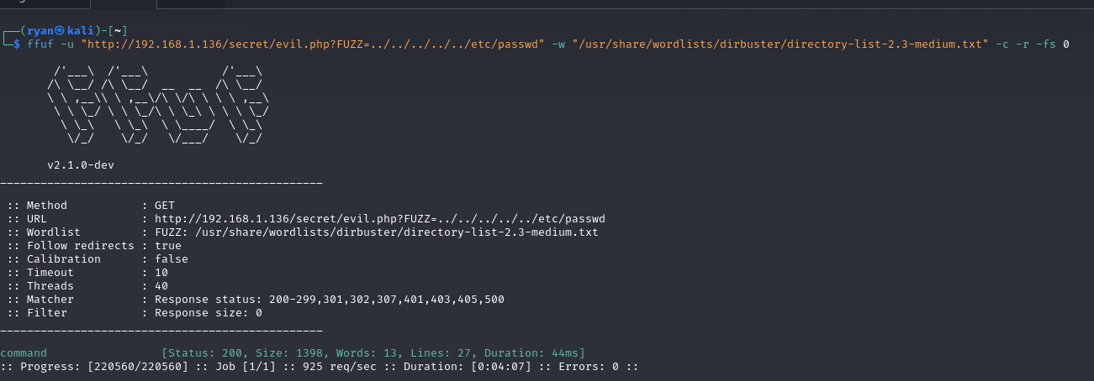
Parameter Fuzzing – Discovering LFI on evil.php
After discovering evil.php, we used FFUF to fuzz for valid parameters. The wordlist attempted common parameter names like cmd, exec, file, page, and command.
Only the parameter command returned a non-zero response – and it successfully read /etc/passwd via path traversal.
This confirms a Local File Inclusion vulnerability.
On EvilBox: ONE, this could have been used to read the user flag or source code before obtaining SSH access. Further exploitation might lead to Remote Code Execution if we can write to logs or upload files

Slide 7
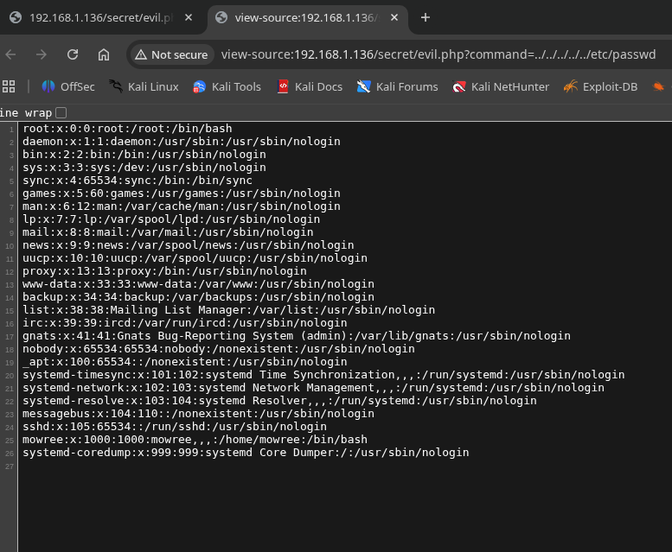
LFI Exploitation – Reading /etc/passwd
Using the LFI vulnerability on evil.php, we read the /etc/passwd file. The output shows standard system accounts, but the important discovery is user mowree – the only human user with a bash shell.
This confirms that compromising mowree is the key to accessing the system.
We also see that www-data runs the web server, and sshd indicates SSH is active – both useful for later lateral movement.
No password hashes are visible because they're stored in /etc/shadow, which requires root privileges or additional vulnerabilities to read.

Slide 8
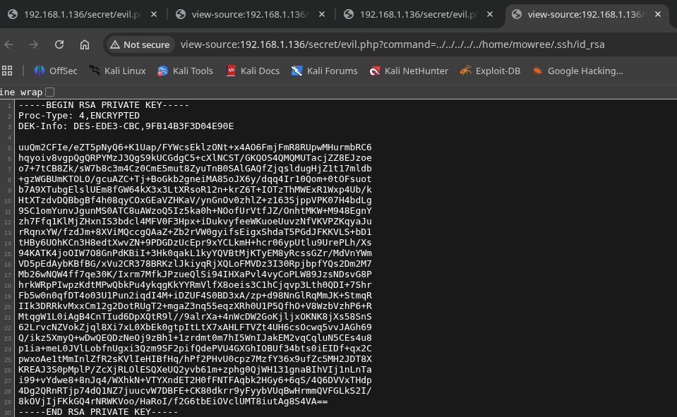
LFI Exploitation – Stealing SSH Private Keys
Using the LFI vulnerability on evil.php, we navigated to mowree's .ssh directory and successfully retrieved the private SSH key.
The key is encrypted with Triple DES, indicated by the DEK-Info header and Proc-Type: ENCRYPTED flags.
This explains why we were prompted for a passphrase when connecting via SSH – the private key requires a password to be used.
Without the passphrase, the key alone is useless to an attacker. However, with offline brute-force tools, a weak passphrase could be cracked, granting undetected access to the system.

Slide 9
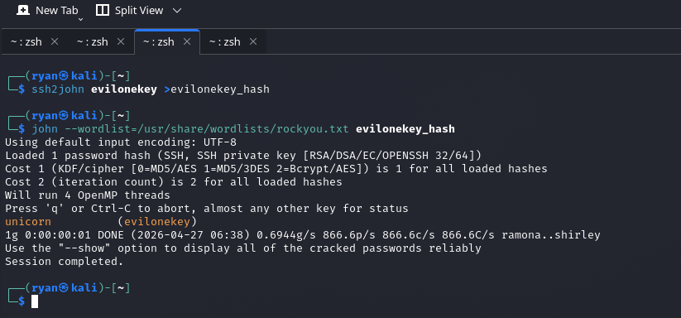
Cracking the SSH Private Key – Password Recovery
With the encrypted SSH key in hand, we used ssh2john to convert it into a hash format compatible with John the Ripper.
Using the famous rockyou.txt wordlist – which contains over 14 million real-world leaked passwords – John cracked the passphrase unicorn in less than one second.
This highlights a critical failure: the user mowree chose an extremely weak password for their private key.
With the passphrase unicorn, an attacker can now use the private key without any interactive prompts, enabling fully automated and stealthy access to the target system.

Slide 10
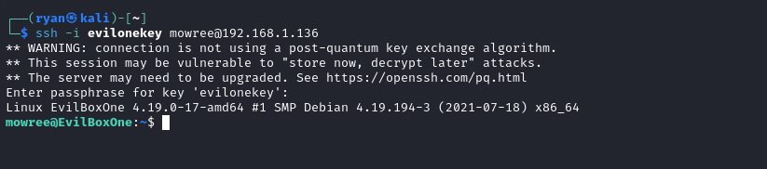
Initial Access – SSH Connection to EvilBox:ONE
With the cracked passphrase unicorn, we used ssh -i evilonekey to connect to 192.168.1.136 as user mowree.
The SSH client displayed a warning about post-quantum cryptography – this is not an immediate threat but highlights future risks of quantum computing breaking today's encryption.
After entering the passphrase, we gained shell access as mowree, confirmed by the prompt mowree@EvilBoxOne:~$.
From here, we captured the user flag and began the privilege escalation phase, where we discovered the writable /etc/passwd file.

Slide 11
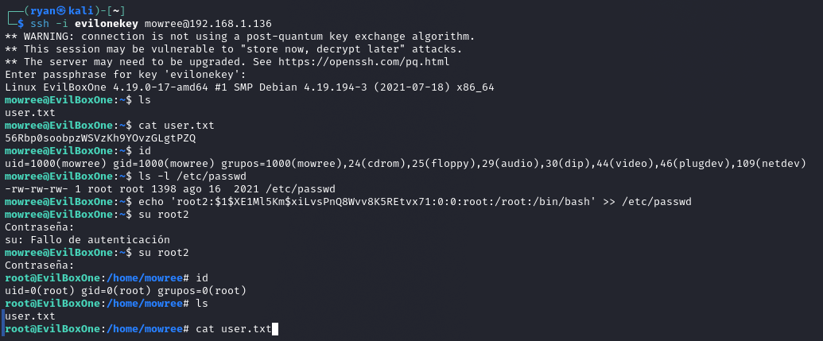
Privilege Escalation – From Standard User to Root
After gaining initial access as mowree, we immediately checked for privilege escalation vectors. The command ls -l /etc/passwd revealed a critical misconfiguration: the file had world-writable permissions (-rw-rw-rw-).
This allowed any user to modify the password file. We crafted a new entry for a user named root2, setting its UID and GID to 0 – the same as the real root user.
The password hash was generated using openssl passwd -1 password123.
Initially, we encountered an authentication failure – likely due to a password typo or hash mismatch – but on the second attempt, we successfully switched to root2 and gained full root privileges, confirmed by the # prompt and id command showing uid=0(root).
From here, we can read any file, modify any configuration, and fully compromise the system.

Slide 12
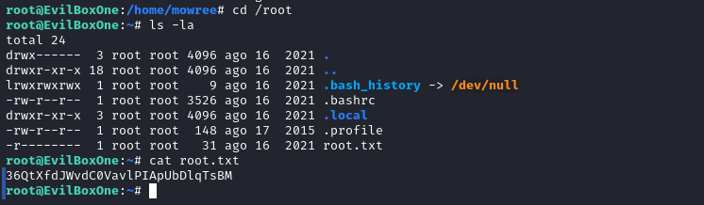
Final Victory – Capturing the Root Flag
With root access confirmed, we navigated to /root – the home directory of the superuser. A long listing revealed several standard configuration files: .bashrc, .profile, and .local.
Notice that .bash_history is symlinked to /dev/null – this prevents any command history from being saved, a common anti-forensics technique.
The file we're interested in is root.txt, with permissions r-------- – only readable by root.
We displayed its contents with cat root.txt, revealing the final flag: 36QtXfdJwvdC0VavLPIApUbDlqTsBM.
This marks the successful completion of the EvilBox: ONE challenge – from initial network discovery to full system compromise

Slide 13
Lessons Learned (Key Takeaways) For Blue Teams (Defenders): Never make /etc/passwd writable – chmod 644 /etc/passwd Remove web shells immediately – Scan for evil.php, cmd.php, etc. Monitor file integrity – Alert on /etc/passwd changes Use SHA-512 password hashing – MD5 is deprecated Restrict .ssh directory access – Web server should not read it For Red Teams (Attackers): Always check /etc/passwd permissions – Quick win for priv esc LFI can lead to full compromise – Chain with key extraction Wordlists work – rockyou.txt cracked unicorn instantly Add root users directly – When /etc/passwd writable, UID=0 is key

Slide 14
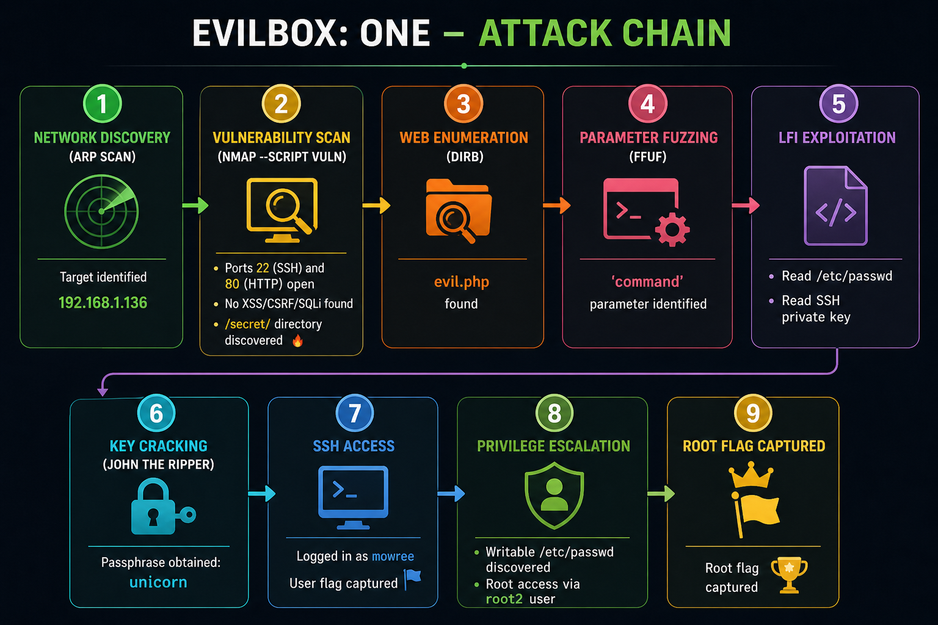

Slide 15
EvilBox: ONE has been successfully rooted. This walkthrough demonstrated: • Proper enumeration techniques • Chaining multiple vulnerabilities • The critical importance of file permissions • How one weak link (writable /etc/passwd) breaks all security exploited by: ryan brian odhiambo

